Slide 1
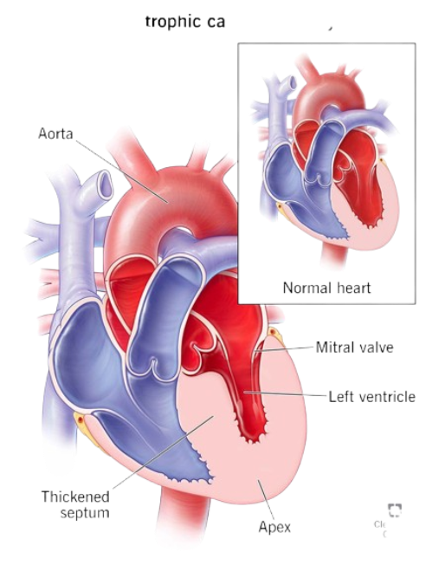
Computational Identification of Differentially Expressed Genes and Pathways Associated with Hypertrophic Cardiomyopathy Using R
DEPARTMENT OF BIOINFORMATICS
SCHOOL OF LIFE SCIENCES
BHARATHIDASAN UNIVERSITY
TIRUCHIRAPALLI-620024
PRESENTED BY
R. AKSHAI KUMAR,
IV yr M.Sc. Bioinformatics (Integrated),
Department of Bioinformatics,
Bharathidasan University,
Trichy -24.

Slide 2
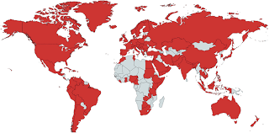
INTRODUCTION
Hypertrophic Cardiomyopathy (HCM) is one of the most common inherited cardiovascular disorders, affecting approximately 1 in 500 individuals worldwide.
It is primarily characterized by abnormal thickening (hypertrophy) of the heart muscle, especially the left ventricular wall and interventricular septum.
Investigating gene expression changes in Hypertrophic Cardiomyopathy helps identify significantly expressed genes and the biological pathways that contribute to disease development and progression.
The availability of high-throughput transcriptomic datasets in public repositories such as the Gene Expression Omnibus (GEO) allows researchers to analyze gene expression patterns and identify genes associated with disease mechanisms.
In this study, I analyzed an HCM gene expression dataset obtained from GEO to identify differentially expressed genes (DEGs) between HCM and normal samples.
Differential expression analysis was performed using DESeq2 package, followed by KEGG pathway enrichment analysis using clusterprofiler package to determine the biological pathways involved in the disease.

Slide 3
AIM & OBJECTIVE
AIM:
To identify differentially expressed genes and associated biological pathways involved in Hypertrophic Cardiomyopathy using R.
OBJECTIVES :
To retrieve and analyze gene expression data of Hypertrophic Cardiomyopathy (HCM) from the public repository Gene Expression Omnibus (GSE180313) to investigate disease-associated transcriptional changes.
To perform differential gene expression analysis using the DESeq2 framework in order to identify significantly upregulated and downregulated genes between HCM and control samples.
To functionally characterize the identified differentially expressed genes through KEGG pathway enrichment analysis using Clusterprofiler, thereby determining the key biological pathways associated with HCM.
To visualize and interpret the enriched pathways using graphical representations in order to highlight the major pathways and genes potentially involved in the molecular mechanisms of HCM.

Slide 4
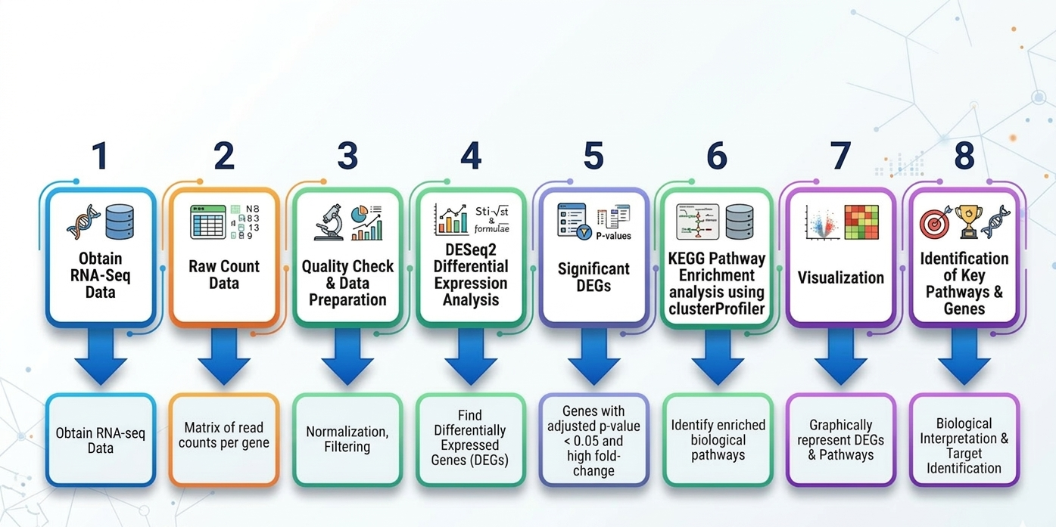
METHODOLOGY

Slide 5
DIFFERENTIALLY EXPRESSED GENES RESULTS

Slide 6
Differentially Expressed Genes in Hypertrophic Cardiomyopathy
Differential gene expression analysis using DESeq2 identified several genes that were significantly altered between Hypertrophic Cardiomyopathy (HCM) cardiac tissue and normal donor controls.
S.NO | Padj | Genes
1 | 5.34E-43 | FCN3
2 | 5.02E-38 | IRX1
3 | 2.00E-35 | SEZ6L
4 | 8.19E-29 | ITIH5
5 | 2.09E-25 | CYS1
6 | 5.62E-23 | LCN6
7 | 1.83E-21 | SFRP4
8 | 2.63E-21 | HMOX2
9 | 1.00E-20 | LTBP4
10 | 1.52E-19 | CCND1

Slide 7
Highly Expressed Genes in Hypertrophic Cardiomyopathy
Differential gene expression analysis using DESeq2 identified several genes that were significantly upregulated in myocardial tissues of Hypertrophic Cardiomyopathy (HCM) patients compared with normal donor hearts.
A set of 10 highly expressed genes were detected, including:
S.NO | Log2Fold Value | Genes
1 | 7.40E-06 | RFPL4A
2 | 2.04E-05 | RFPL4AL1
3 | 8.27E-08 | EDN3
4 | 4.96E-07 | CST2
5 | 2.00E-35 | SEZ6L
6 | 4.29E-09 | ESM1
7 | 3.16E-08 | SIGLEC17P
8 | 5.78E-09 | CUX2
9 | 1.46E-11 | GSG1L
10 | 9.92E-12 | VGLL2

Slide 8
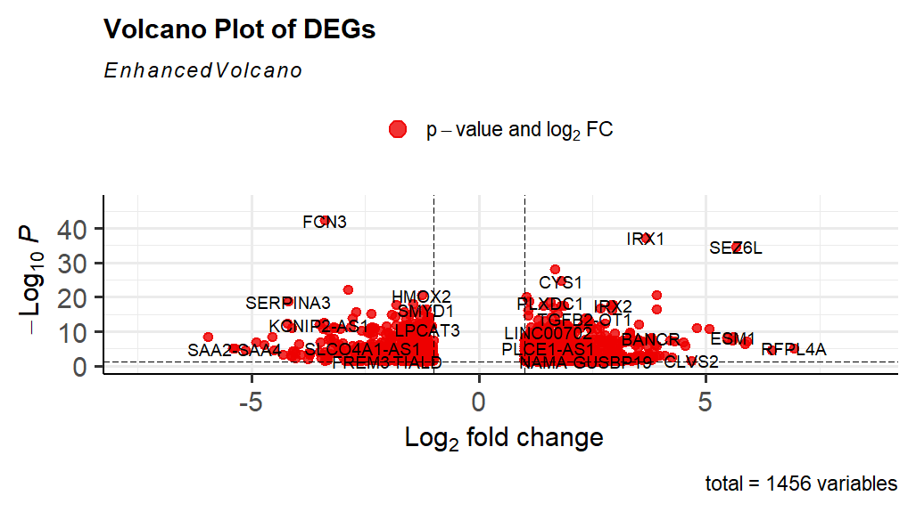
Volcano Plot of Differentially Expressed Genes
The volcano plot highlights genes with both high fold change and strong statistical significance, indicating potential roles in the molecular mechanisms of Hypertrophic Cardiomyopathy.

Slide 9
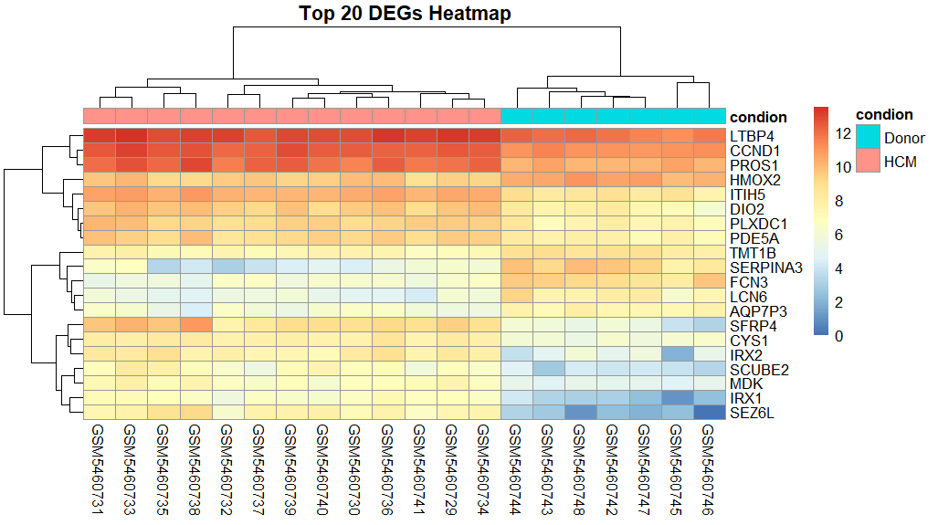
Heatmap of Top DEGs
The heatmap shows clear clustering between HCM samples and donor controls, indicating distinct gene expression patterns associated with Hypertrophic Cardiomyopathy.

Slide 10
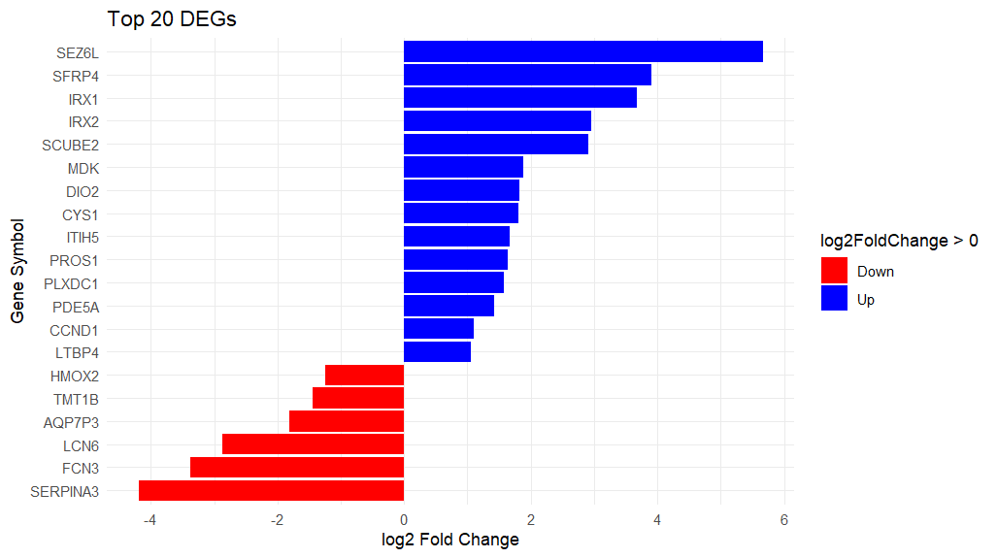
Top Differentially Expressed Genes
The Barplot show strong expression differences between HCM and normal samples and may play roles in cardiac remodeling, signaling pathways, and extracellular matrix regulation.

Slide 11
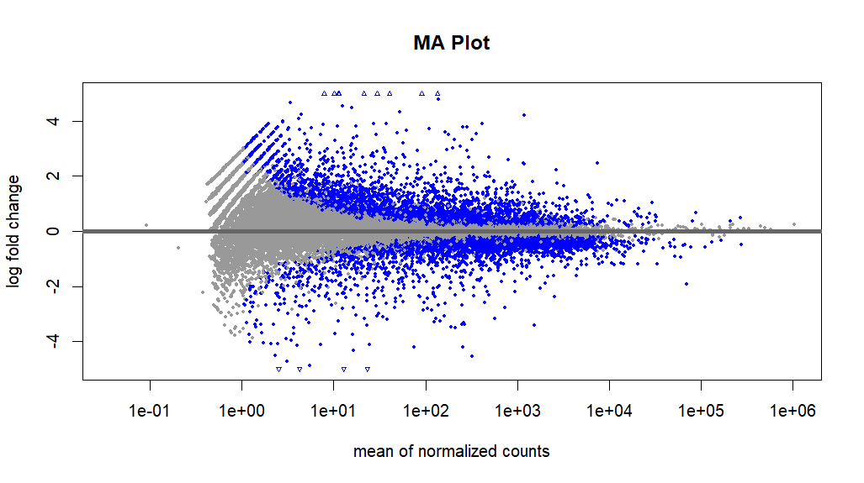
Differential Gene Expression (MA Plot)
The MA plot demonstrates the distribution of gene expression changes between HCM and control samples. A substantial number of genes show significant upregulation and downregulation, indicating transcriptional alterations associated with Hypertrophic Cardiomyopathy.

Slide 12
KEGG PATHWAY ENRICHMENT ANALYSIS RESULTS

Slide 13
KEGG PATHWAY ENRICHMENT ANALYSIS
Functional enrichment analysis was performed using KEGG pathway enrichment analysis to identify biological pathways associated with the differentially expressed genes.
The top enriched pathways include:
Neuroactive ligand-receptor interaction
Complement and coagulation cascades
Neuroactive ligand signaling
Cytoskeleton in muscle cells
Calcium signaling pathway
Integrin signaling
ECM-receptor interaction
Cytokine-cytokine receptor interaction

Slide 14
Genes from Important Pathways
Calcium Signaling Pathway:
AGTR1, EDNRA, NOS2, ATP2A2, CAMK1G, RYR3, CACNA1B, CACNA1E.
These genes are involved in cardiac muscle contraction and calcium regulation, which are critical for heart function.
Cytoskeleton in Muscle Cells
MYH2, MYH6, MYL1, MYL7, TNNT1, TNNT3, TPM3.
These genes play essential roles in muscle contraction and structural organization of cardiac muscle fibers.
ECM-Receptor Interaction
COL9A1, COL9A2, FN1, THBS2, THBS4, ITGA7.
These genes are associated with extracellular matrix remodeling, a process often observed in cardiac hypertrophy.

Slide 15
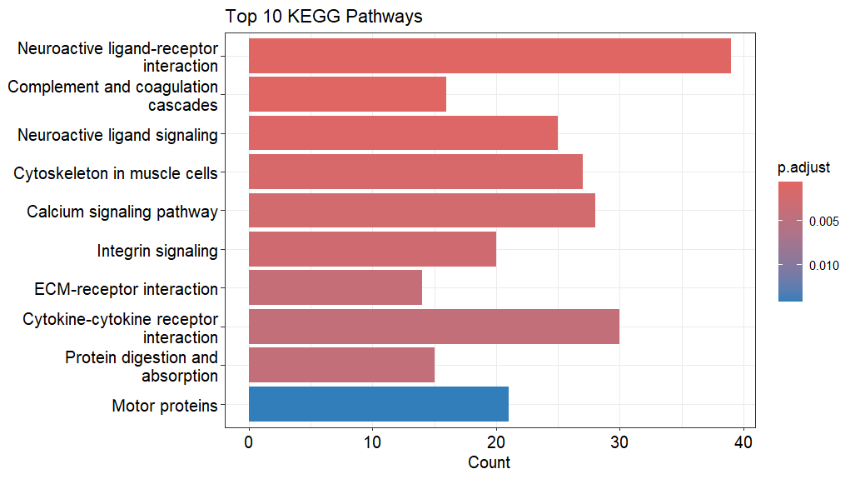
KEGG PATHWAY ENRICHMENT ANALYSIS Bar Plot VISULAIZATION
These pathways related to cell signaling, extracellular matrix organization, and muscle structure were significantly enriched, suggesting their potential involvement in the molecular mechanisms of Hypertrophic Cardiomyopathy.

Slide 16
CONCLUSION
In this study, gene expression data obtained from the Gene Expression Omnibus (GEO) database[ID: GSE180313] were analyzed to investigate transcriptional changes associated with Hypertrophic Cardiomyopathy.
Differential gene expression analysis using the DESeq2 identified several significantly upregulated and downregulated genes between HCM and control samples.
Visualization techniques such as volcano plots, MA plots, and heatmaps revealed clear differences in gene expression patterns between the two groups.
The top differentially expressed genes, including SEZ6L, IRX1, IRX2, SCUBE2, and MDK, showed strong upregulation, while genes such as SERPINA3, FCN3, and LCN6 were significantly downregulated. These genes may play important roles in the molecular mechanisms underlying HCM.

Slide 17
Functional enrichment analysis using KEGG pathway enrichment analysis revealed several significantly enriched pathways, including:
Neuroactive ligand–receptor interaction
Calcium signaling pathway
Cytoskeleton organization in muscle cells
ECM–receptor interaction
Cytokine–cytokine receptor interaction
These pathways are associated with cell signaling, muscle contraction, extracellular matrix remodeling, and inflammatory responses, which are key biological processes involved in cardiac hypertrophy and structural remodeling of the heart.
Overall, this study highlights important genes and biological pathways that may contribute to the pathogenesis of Hypertrophic Cardiomyopathy, providing insights into the molecular mechanisms of the disease and potential targets for further investigation.

Slide 18
REFERENCE
Transcriptomic Analyses and Experimental Validation Identified Immune‑Related lncRNA–mRNA Pair MIR210HG–BPIFC Regulating the Progression of Hypertrophic Cardiomyopathy International Journal of Molecular Sciences, 2024.
Integration of Transcriptomic Data Identifies Key Hallmark Genes in Hypertrophic Cardiomyopathy BMC Cardiovascular Disorders, 2021.
Transcriptomic Analysis and Machine Learning Modeling Identifies Novel Biomarkers and Genetic Characteristics of Hypertrophic Cardiomyopathy Frontiers in Genetics, 2025.
A Personalized mRNA Signature for Predicting Hypertrophic Cardiomyopathy Applying Machine Learning Methods
Transcriptome Analysis of Human Hypertrophic Cardiomyopathy Reveals Inhibited Cardiac Development Pathways in Children iScience, 2023.

Slide 19
Characterization of the Circulating Transcriptome Expression Profile and Identification of Novel miRNA Biomarkers in Hypertrophic Cardiomyopathy European Journal of Medical Research, 2023.
Whole‑Exome Sequencing Reveals Mutational Signature of Hypertrophic Cardiomyopathy International Journal of General Medicine, 2023.
Transcriptomic Profiling Reveals Molecular Mechanisms and Biomarkers in Hypertrophic Cardiomyopathy Frontiers in Cardiovascular Medicine, 2022.
Identification of Key Genes and Pathways Associated with Hypertrophic Cardiomyopathy by Integrated Bioinformatics Analysis BioMed Research International, 2022.
Identification of Differentially Expressed Genes and Key Pathways in Hypertrophic Cardiomyopathy Using Bioinformatics Analysis Journal of Cellular and Molecular Medicine, 2021.

Slide 20


